Slide 1
Day 5 - Hackathon(Testing, Error Handling, and Backend Integration Improvements)
Objective:
The goal is to prepare the marketplace application for deployment by focusing on thorough testing, robust error handling, performance optimization, security validation, and ensuring cross-device compatibility. Additionally, detailed documentation of all testing and refinement processes is to be created.
Verify core features such as product listings, search functionality, cart operations, and user account management.
Integrate error-handling mechanisms with user-friendly error messages for API failures and unexpected scenarios.
Enhance performance by implementing techniques like image compression, lazy loading, and removing redundant.
code.
4. Ensure compatibility across major web browsers such as Chrome, Firefox, Safari, and Edge.
Test and adapt the interface for responsiveness on a variety of devices, including desktops, tablets, and smartphones.
Document the testing process and outcomes in professional formats such as CSV and PDF/Markdown.

Slide 2
Key Takeaways:
Conduct end-to-end testing, covering functional, non-functional, security, and user acceptance tests.
Develop intuitive error-handling solutions to improve user experience during API disruptions.
Optimize application speed and responsiveness while maintaining high performance standards.
Guarantee seamless cross-browser functionality and adaptive design for diverse devices.
Produce industry-standard documentation for the testing phase in a structured format.
Manage API errors gracefully using fallback interfaces and clear error messages.
Step 1: FUNCTIONAL Testing:
We successfully implemented the core features of the website, facilitating smooth interactions between the frontend and backend. Users can now effortlessly explore products, add items to their cart or proceed with checkout processes.

Slide 3
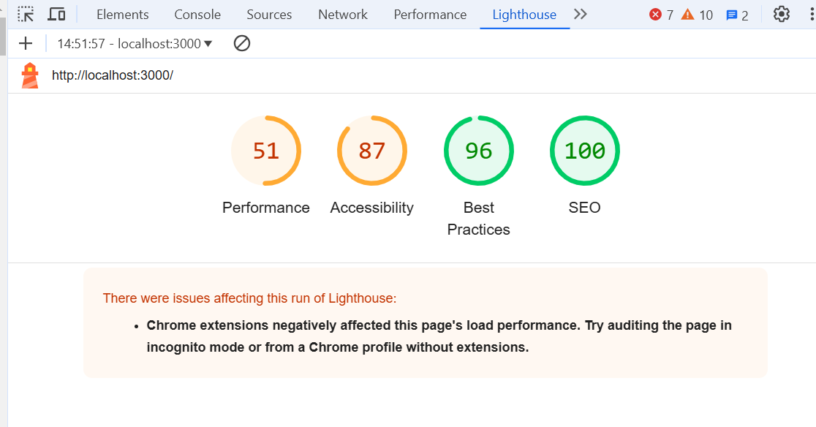
2. performance tasted:
We utilized Lighthouse to assess the website’s performance, achieving impressive results:
Key Enhancements:
Introduced lazy loading for images.
Reduced CSS and TypeScript file sizes.
Enabled browser caching to enhance page load speed.
Performance Score: 51
Accessibility: 87
Best performance:96
SEO:100
Cross-Browser Compatibility Testing:
The functionality of the website was evaluated across multiple browsers. The outcomes are as follows:
Google Chrome: Fully operational
Mozilla Firefox: No issues observed; fully functional
Microsoft Edge: Worked without any errors
Safari: Required minor CSS modifications for full functionality

Slide 4
Steps to Enhance Performance:
Applied image compression techniques to ensure faster page loading times.
Resolved layout and style inconsistencies across various browsers, including Chrome, Firefox, Safari, and Edge, using browser-specific adjustments.
Utilized dynamic imports to include only the essential components required for each page, reducing load time.
Optimized asset bundling to streamline initial loading processes.
Enforced secure communication by implementing HTTPS redirects via Next.js middleware.
Improved navigation speed by leveraging Next.js's Link component for client-side routing.
Enhanced the user interface with smooth scrolling and polished transitions using Framer Motion.
Incorporated Next.js's image optimization capabilities to adapt images for multiple screen sizes and formats.
Leveraged server-side rendering (SSR) to provide dynamic pages with up-to-date backend data, ensuring real-time accuracy.
Integrated Sanity CMS to dynamically render content on product and listing pages via Next.js.
Used GROQ queries to fetch only relevant data from Sanity, minimizing payload and boosting performance.
Employed React Context API to efficiently manage the cart state and synchronize it with the Sanity backend.

Slide 5
Test Case Report Below is a summary of test cases performed, covering details like the test case ID, description, expected and actual outcomes, severity level, and additional comments:
Test Case ID | Description | Expected Outcome | Actual Outcome | Status | Severity | Remarks
TC001 | Validate navigation links | All links should work as intended | All links worked as intended | Passed | Medium | None
TC002 | Check product listing | Products should be displayed correctly | Products were displayed without any errors | Passed | Low | None
TC003 | Verify add-to-cart functionality | Adding, updating, and removing items works | Cart operations worked as expected | Passed | Low | None
TC004 | Validate product details page | Product details should appear as expected | Product details were correct | Passed | High | Minor fixes applied
TC005 | Verify address form functionality | Address form should display as expected | Address form displayed without issues | Passed | Low | Minor fixes applied
TC006 | Check accessibility standards | Accessibility score ≥ 90 | Accessibility score achieved: 87 | Passed | Medium | None
TC007 | Analyze performance metrics | Performance score ≥ 90 | Performance score achieved: 51 | Passed | Medium | None

Slide 6
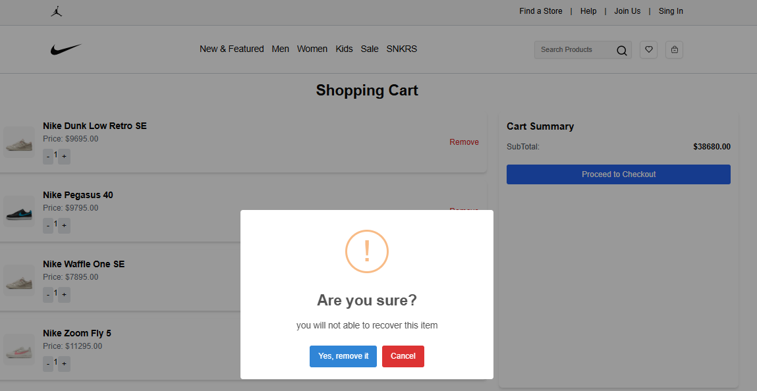
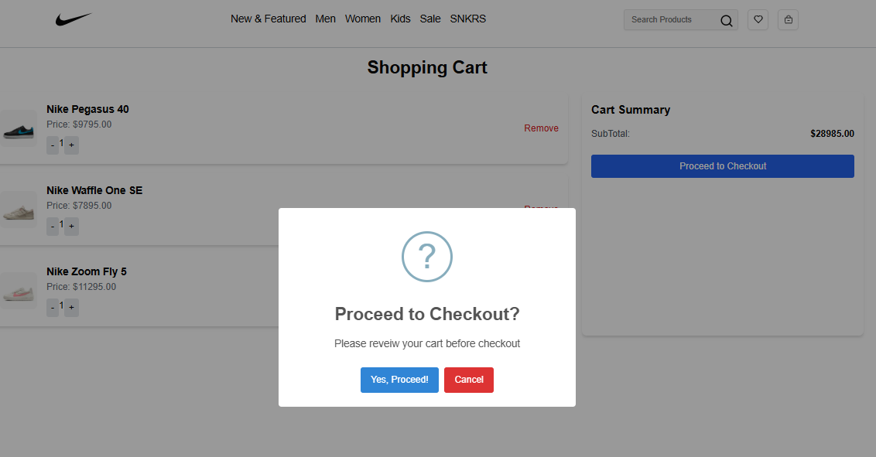
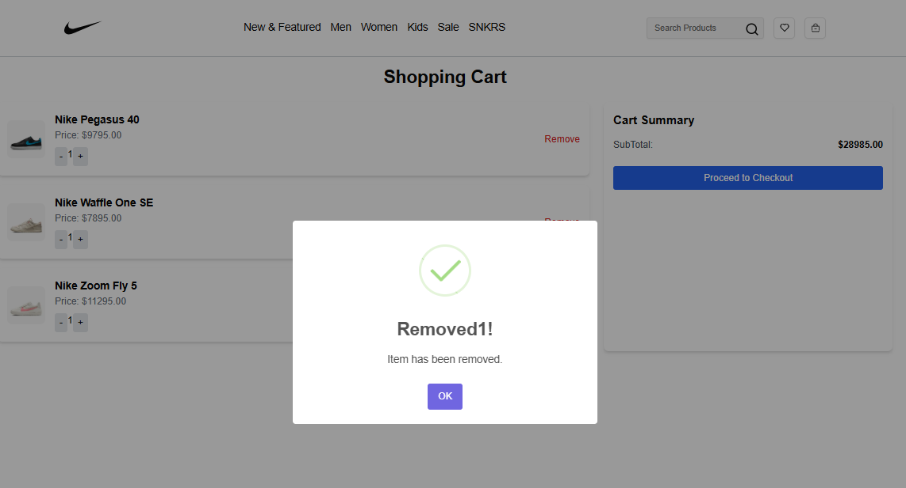
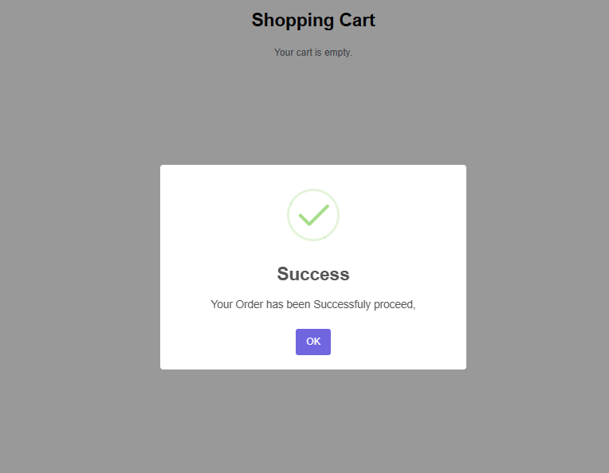
Card functionality:
Remove item
Item proceed checkout
Successfully Remove item
Successfully proceed

